Slide 1
Docker Training
Authored by: Sachin Arote
Presented by: Sachin Arote

Slide 2
Agenda
Infra team – Pain areas
DevOps
Evolution in Virtualization History
Docker
Docker Architecture
Images & Containers
Docker Workflow
Docker vs KVM
Dockerfile
Docker Commands
Docker Registry
Docker Compose
Docker Swarm
Use cases for Docker

Slide 3
Infra team – Pain areas
Dev, Test, Prod environments are different
Prod Env –
Downtime issues
Fire fighting issues
Golden Images
Higher Cost – at machine/VM level
Higher storage requirements for Golden Images
Manual process of creating Environments - for Dev, Test teams
Manual release process

Slide 4
DevOps value addition to Infra team
Same environments for Dev, Test and Prod
Faster to create/manage Environments
Portability of Apps
Easy to build, test and deploy Apps
Deployment automation
Faster and more releases
Lower cost on storage & CPU
Zero downtime
Green/Blue deployment

Slide 5
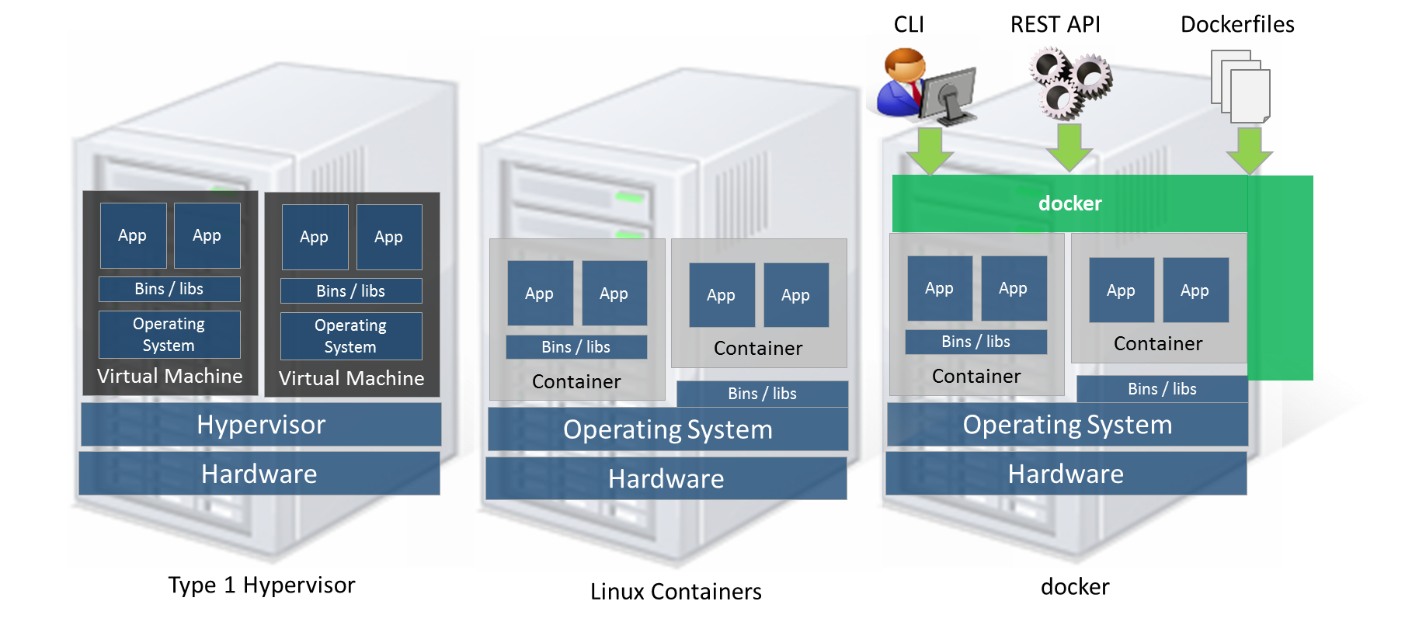
Evolution in Virtualization History

Slide 6
Docker
What is Docker?
Docker automates creation of lightweight - Application container
Container will virtually run anywhere
Same container can run on any laptop, desktop, VM, Cloud & more
Deployment of Applications inside an Container
Unlike VM, it does not include a separate Operating system.
Why docker?
Isolation
Lightweight
Simplicity
Portability
Community

Slide 7
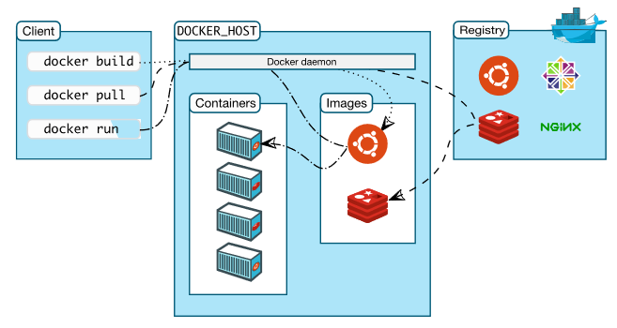
Docker Architecture

Slide 8
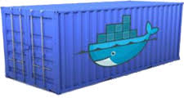
Images & Containers
What is Container ?
“Unit of deployment”
LXC - OS virtualization
Lighter than VM/Golden Images
Images
Docker file build Docker images for use by Docker
Containers
A container is the running instance of that image, which is where the actual work occurs for a "Dockerized" application.
Using an object-oriented programming analogy, the difference between a Docker image and a Docker container is the same as that of the difference between a class and an object. An object is the runtime instance of a class. Similarly, a container is the runtime instance of an image

Slide 9
Dockerfile, Image, Container
h
Dockerfile
image
Container
Run
Build

Slide 10
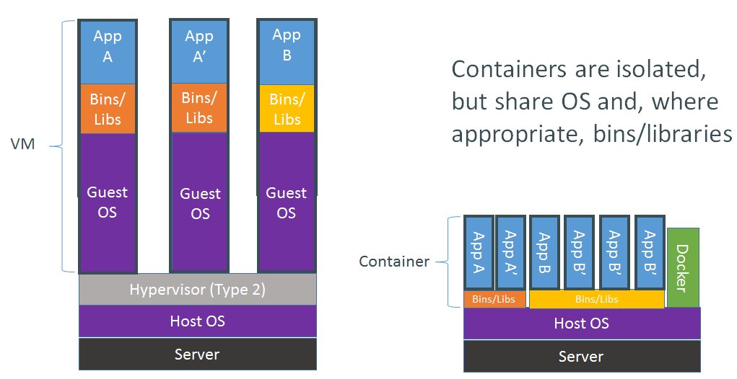
Docker Container vs VM

Slide 11
Docker – value addition for DevOps
Fast
Runtime performance near bare metal speeds
Management operations (run, stop , start, etc.) in seconds / milliseconds
Agile
VM-like agility – it’s still “virtualization”
Flexible
Containerize “application(s)”
Lightweight
Does not have its own Operating System, like a VM
Images only contain bin, lib and app
Inexpensive
Open source – free – lower TCO (total cost of ownership)
Supported with out-of-the-box modern Linux kernel
Ecosystem
16,000+ Apps in Docker Hub
Vibrant community & numerous 3rd party app
All Cloud providers - AWS, VMware, Google App Engine support Docker

Slide 12
Dockerfile
FROM ubuntu
MAINTAINER Sachin Arote
RUN apt-get update
RUN apt-get install -y wget
CMD “bash”

Slide 13
Commands
Command | Description
Build | Builds Docker images from a Dockerfile
Commit | Create a new image from a container's changes
cp | Copy files/folders from a container's filesystem to the host path
create | Create a new container
exec | Run a command in a running container
history | Show the history of an image
images | List images
info | Display system-wide information
inspect | Return low-level information on a container or image
kill | Kill a running container

Slide 14
Commands
Command | Description
load | Load an image from a tar archive
login | Register or log in to a Docker registry server
logout | Log out from a Docker registry server
logs | Fetch the logs of a container
pause | Pause all processes within a container
unpause | Unpause a paused container
port | Lookup the public-facing port that is NAT-ed to PRIVATE_PORT
list | List containers
Pull | Pull an image or a repository from a Docker registry server
push | Push an image or a repository to a Docker registry server

Slide 15
Commands
Command | Description
rename | Rename an existing container
restart | Restart a running container
rm | Remove one or more containers
rmi | Remove one or more images
run | Run a command in a new container
save | Save an image to a tar archive
search | Search for an image on the Docker Hub
start | Start a stopped container
stats | Display a stream of a containers' resource usage statistics
stop | Stop a running container

Slide 16
Commands
Command | Description
tag | Tag an image into a repository
top | Lookup the running processes of a container
version | Show the Docker version information
wait | Block until a container stops, then print its exit code

Slide 17
Docker Registry
A Docker registry stores Docker images.
Docker Hub and Docker Cloud are public registries. By default Docker uses Docker Hub to search for images.
docker pull and docker run command are used to pull the docker images while docker push command is used to push images to the repo

Slide 18

Thank You!!

